Slide 1


Imperial Management Administrator Services
Cultural Awareness & Sensitivity Training

Slide 2

Cultural Awareness & Sensitivity as developed by DHCS, for Seniors and Persons with Disabilities
and Chronic Conditions

Slide 3
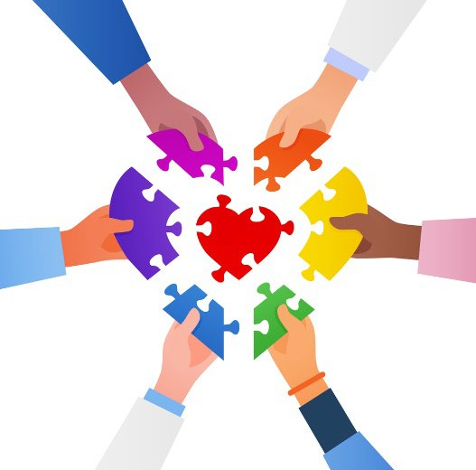
Agenda
Objectives
Overview
Understanding Cultural Differences
What is Cultural Competence?
The strength of cultural competency and diversity
Cultural Competence Continuum
Communication with Culturally Diverse Patients

Slide 4



Objectives
This presentation demonstrates cultural competency strategies that can be used in providing culturally competent health services to our diverse populations and their needs.
We will highlight the importance of developing and demonstrating culturally appropriate behaviors that include but not limited to, knowledge, attitudes, and beliefs for our members, staff, and providers.

Slide 5
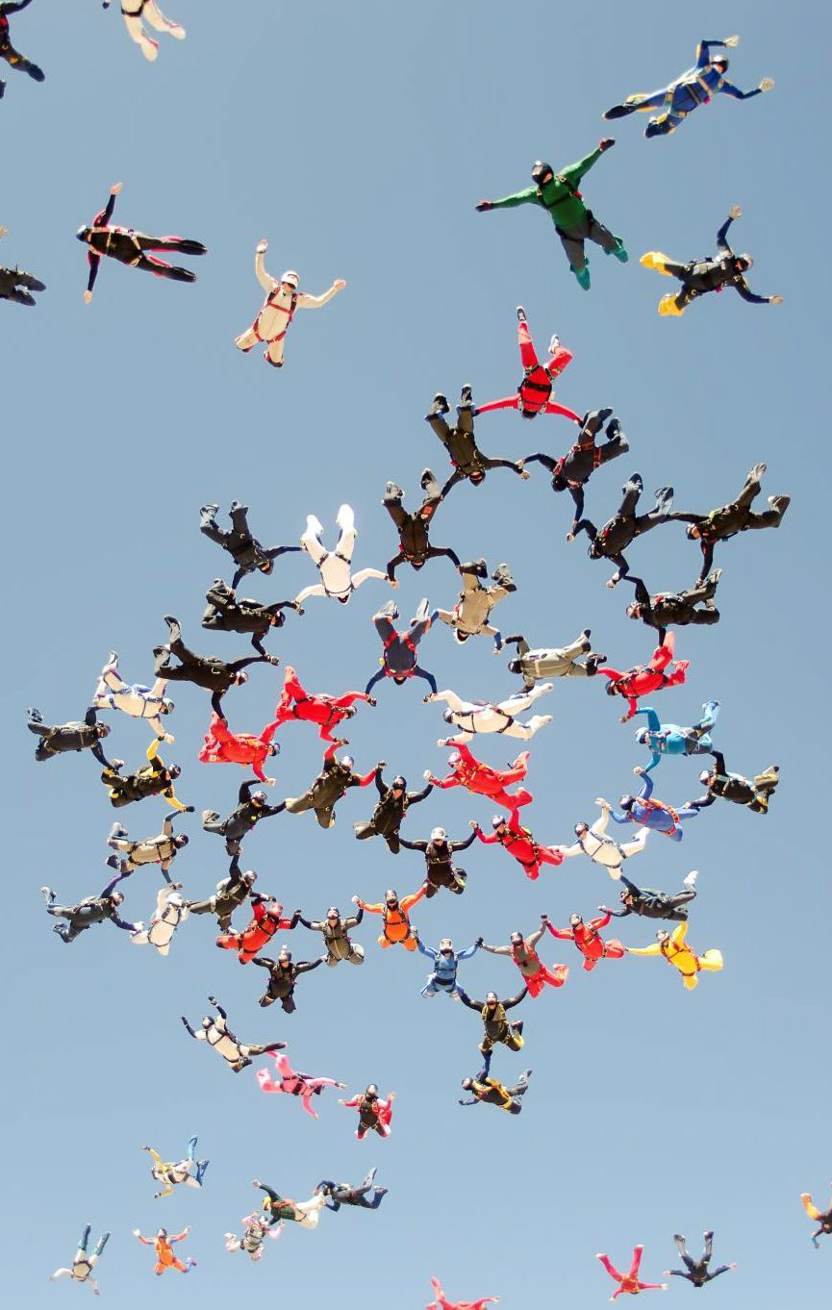
What is Diversity?
Diversity includes characteristics such as gender, religion, nationality, race, sexual orientation, physical abilities, ethnicity and political beliefs, heritage and life experiences.
Individuals can bring a diverse range of experiences, e.g., appearance, likes or dislikes and identity. It is important we value and embrace differences and similarities among staff, patients and health care providers.

Slide 6

Importance of Healthcare Diversity
Diversity in health care helps ensure all backgrounds, beliefs, ethnicities,
and perspectives are adequately represented in the medical field. It’s about
providing the best possible care for all patients. Having Diversity in the
workplace is beneficial for healthcare providers, staff and patients. These benefits include but not limited to:
Ability to provide better care for our diverse population
Having a diverse staffing structure, patients can identify with the staff,
comfortably communicate with their provider and staff, better serve
their individual needs.
Higher employee morale
Diversity creates a stronger feeling of inclusion as a community
for healthcare workers, which makes the workplace feel safer
and more enjoyable.
Better patient experience and outcomes
Patients benefit from a team that understands and relates to
them. Diverse team gets better results. It is important we can
understand our patient’s belief systems and values. This will allow for providers to provide better care for them.

Slide 7
Importance of Cultural Diversity
More than 40 million people living in the U.S. were born in
another country, accounting for about one-fifth of the world’s
migrants. The population of immigrants is also very diverse, with
just about every country in the world represented among U.S. immigrants.
Seniors and Persons with Disabilities are often referred to as an
individual population, but they are actually group of people with a various range of needs.
1 in 4 adults in the United States have some type of disability
People with disabilities constitute the nation’s largest minority group
People with disabilities constitute the largest minority group in the
United States, making up an estimated 20 percent of the total
population. It is a diverse group, crossing lines of age, ethnicity, gender, race, sexual orientation and socioeconomic status.
More than half of LGBTQI+ adults reported that “recent debates
about state laws restricting the rights of LGBTQI+ people”
moderately or significantly affected their mental health or made
them feel less safe, including more than 8 in 10 transgender or nonbinary individuals.
Approximately 1 in 3 LGBTQI+ adults reported encountering at
least one kind of negative experience or form of mistreatment
when interacting with a mental health professional in the past
year, including 4 in 10 LGBTQI+ people of color and more than 1 in 2 transgender or nonbinary individuals.
Budiman, A. (n.d.). Key findings about U.S. immigrants. Pew Research Center. Retrieved May 17, 2023, from https://www.pewresearch.org/short-reads/2020/ 08/20/k ey-findi ngs-ab out-u-s-i mmigra nts/#:~:text=T oday%2C%20more%2 0than% 2040%2 0million
CDC. (2023, January 5). Disability Impacts All of Us Infographic | CDC. Centers for Disease Control and Prevention. https://www.cdc.gov/ncbddd/disabil ityandhealth/i nfograp hic-disa bility-i mpacts-all.html #:~:text =Up%2 0to%20 1%20in%204
Disability Stats and Facts | Disability Funders Network – The Social Justice Movement of the 21st Century…Building a Bridge Between Disability and Community Philanthropy. (n.d.). Www.disabilityfunders.org. https://www.disabilityfunders.org/disabilit y-stats-and-facts#:~:te xt=People%20with%20disabi lities% 20consti tute%20the% 20largest%20minority %20gro up%20i n%20th e Medina, C., & Mahowald, L. (2023, January 12). Discrimination and Barriers to Well-Being: The State of the LGBTQI+ Community in 2022. Center for American Progress. h ttps://www.americanprogress.org/articl e/discri mination-and-barriers-to-well-being-t he-stat e-of-the-lgbtqi-community-in-2 022/

Slide 8

Cultural respect is being respectful of and responsive to the health beliefs, practices, and cultural and linguistic needs of diverse patients.
National Institutes of Health. (2021). Cultural respect. National Institutes of Health (NIH). https://www.nih.gov/institutes-nih/nih-office-director/office-communications-public-liaison/clear-communication/cultural-respect
U.S. Department of Health & Human Services. (2020). Culturally and Linguistically Appropriate Services. Think Cultural Health. https://thinkculturalhealth.hhs.gov/clas
Cultural respect is critical to reducing health disparities. It helps improve access to high-quality health care that is respectful of and responsive to the needs of diverse patients.
Cultural respect enables systems, providers, and groups of professionals to function effectively to understand the needs of groups accessing health information and health care.
Cultural Respect
The National Standards for Culturally and Linguistically Appropriate Services (NCLAS) Standards are a set of 15 action steps intended to advance health equity, improve quality, and help eliminate health care disparities, thereby influencing cultural respect as a critical element to achieving better health outcomes, implementing culturally and linguistically appropriate services.

Slide 9
Importance of Cultural Respect
National Institutes of Health. (2021). Cultural respect. National Institutes of Health (NIH). https://www.nih.gov/institutes-nih/nih-office-director/office-communications-public-liaison/clear- communication/cultural-respect
U.S. Department of Health & Human Services. (2020). Culturally and Linguistically Appropriate Services. Think Cultural Health. https://thinkculturalhealth.hhs.gov/clas
Culture is often described as the combination of knowledge, belief,
and behavior. It involves several elements that are often specific to ethnic, racial religious, geographic, or social groups.
This includes personal identification, language, thoughts,
communications, actions, customs, beliefs, values, and institutions. As
healthcare providers, it is important to recognize these elements that
may influence patients’ actions or inactions surrounding health, healing, wellness, illness, disease, and delivery of health services.
The concept of Cultural Respect has a positive effect on patient care
delivery by enabling providers to deliver services that are respectful of
and responsive to the health beliefs, practices, and cultural and linguistic needs of diverse patients.

Slide 10

Cultural Differences
Did you know?
Health beliefs: In some cultures, people believe that talking about a possible poor health outcome will cause that outcome to occur.
Health customs: In some cultures, family members play a large role in health care decision making.
Ethnic customs: Differing roles of women and men in society may determine who makes decisions about accepting and following through with medical treatments.
Religious beliefs: Religious faith and spiritual beliefs may affect health care-seeking behavior and people's willingness to accept specific treatments or behavior changes.
Dietary customs: Disease-related dietary advice will be difficult to follow if it does not conform to the foods or cooking methods used by the patient.
Interpersonal customs: Eye contact or physical touch will be expected in some cultures and inappropriate or offensive in others.
Agency for Healthcare Research and Quality. (2015, February). Consider Culture, Customs, and Beliefs: Tool #10. Www.ahrq.gov. https://www.ahrq.gov/health- literacy/improve/precautions/tool10.html

Slide 11

Cultural Competence
Cultural competence is a set of behaviors and attitudes that professionals use to:
Show respect for another culture’s values and identity
Respect and value diversity and cultural differences in their patients
Respect diversity and cultural differences in their workforce
Learn to adjust to the culture of the family or community they are serving
Work effectively in a sensitive and multicultural setting
Establish Clear Communication
Ask about potentially relevant traditions and customs
Use respectful statements when discussing sensitive topics including cultural or religious customs
Green, A. (2020, February 14). Cultural Awareness in Healthcare: A Checklist. Qualityinteractions.com. https://www.qualityinteractions.com/blog/cultural-awareness-in-healthcare-checklist

Slide 12
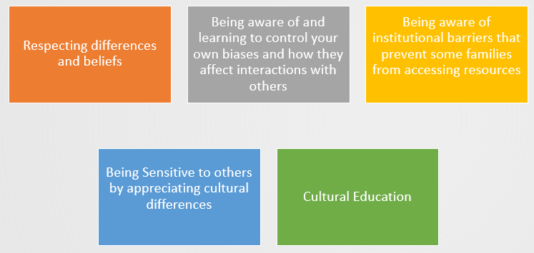
Cultural Competence Skills
Building strong multi cultural team relationships
Advocating for individuals who are different from yourself
Patient Preference for Traditional Treatment
Religious Beliefs and Care Delivery
Using effective communication skills across differences
Intervening and providing resolution for cross cultural conflicts
Being flexible

Slide 13
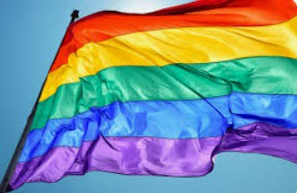
Diversity includes LGBTQIA Members/Patients
LGBTQIA+ refers to lesbian, gay, bisexual, transgender, queer, intersex, asexual & all sexual & gender minority people.
Lesbian or gay is a sexual orientation that describes a person who is emotionally & sexually attracted to people of the same gender.
Bisexual is a sexual orientation that describes a person who is emotionally & sexually attracted to people of the same gender & people of other genders.
Straight (heterosexual) is a sexual orientation that describes a person who is emotionally & sexually attracted to people of a different gender.
Transgender describes a person whose gender identity, gender expression or behavior & sex assigned at birth does not conform to typically associated behaviors based on traditional expectations; for example, a person assigned female sex at birth who identifies as a man; or a person assigned male sex at birth who identifies as a woman. Transgender can also include people with gender identities outside the girl/woman and boy/man gender binary structure; for example, people who are gender fluid or non-binary. Sometimes abbreviated as trans
Lesbian, Gay, Bisexual, Transgender, Queer, and Intersex (LGBTQI+). (n.d.). Www.samhsa.gov. https://www.samhsa.gov/behavioral-health-equity/lgbtqi
Sexual Orientation. (n.d.). Myhealth.alberta.ca. https://myhealth.alberta.ca/Alberta/Pages/sexual-orientation.aspx
American Psychological Association. (2023, March 9). Understanding transgender people, gender identity and gender expression. Apa.org. https://www.apa.org/topics/lgbtq/transgender-people-gender-identity-gender-expression

Slide 14

Diversity includes LGBTQIA Members/Patients
Queer is a an umbrella term describing people who think of their sexual orientation or gender identity as outside of societal norms. Some people view the term queer as more fluid and inclusive than traditional categories for sexual orientation and gender identity. Although queer was historically used as a slur, it has been reclaimed by many as a term of empowerment. Nonetheless, some still find the term offensive
Intersex describes a group of congenital conditions in which the reproductive organs, genitals &/or other sexual anatomy do not develop according to traditional expectations for females or males. Intersex can also be used as an identity term for someone with one of these conditions.
Asexual describes a person who experiences little or no sexual attraction to others. Asexual people may still engage in sexual activity.
Lesbian, Gay, Bisexual, Transgender, Queer, and Intersex (LGBTQI+). (n.d.). Www.samhsa.gov. https://www.samhsa.gov/behavioral-health-equity/lgbtqi
Sexual Orientation. (n.d.). Myhealth.alberta.ca. https://myhealth.alberta.ca/Alberta/Pages/sexual-orientation.aspx
American Psychological Association. (2023, March 9). Understanding transgender people, gender identity and gender expression. Apa.org. https://www.apa.org/topics/lgbtq/transgender-people-gender-identity-gender-expression

Slide 15
Assumptions
Do Not Make Assumptions!
Unconscious biases are learned assumptions, beliefs, or attitudes that we aren’t necessarily aware of. While bias is a normal part of human brain function, it can often reinforce stereotypes
Assumptions from judgements we make based on a person’s appearance, age, race, ethnicity, religion, sex, gender, language, weight and economic status often lead to misjudgments.
We may decide we may not need to “hear” what people have to say because we have unconsciously decided that they have nothing to contribute based on our own biases about the person’s appearance or situation.
Our assumptions may affect our ability to communicate effectively with those who are different from us.

Slide 16
Labels
Labelling is closely interlinked with stereotyping - it occurs when an individual or group are exposed to subjective views which lead to them being associated with or categorized according to the viewers own experiences and opinions. Those individuals being observed are then associated with certain behaviors.
We may use labels or categories to describe others.
Labels can be based on certain characteristics including but not limited to their clothing, looks, the way a person talks, or the groups to which he or she belongs.
Grouping is a natural human inclination; however, people often make assumptions about groups of people they don’t even know.

Slide 17
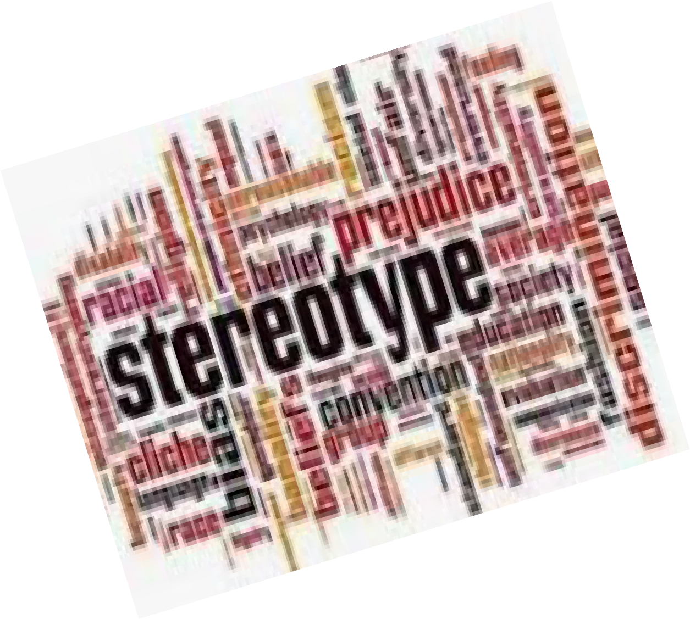
Stereotyping
Bias and Stereotypes affects how people perceive others who look, think, or behave differently.
Stereotyping occurs when we use misinformation to judge everyone who belongs to a specific group.
o For example, if we are walking through a park late at night and encounter three senior citizens wearing fur coats and walking with canes, we may not feel as threatened as if we were met by three high school-aged boys wearing leather jackets. Why is this so? Because we have made a generalization in each case.
Stereotypes also evolve out of fear of persons from minority groups.

Slide 18

How to Avoid Stereotyping
Acknowledge the existence of your own preconceptions.
Be critical of yourself. Don't take for granted any opinion that pops into your head.
Work to understand how your preconceptions impact the way you view others.
Know your labels and to whom you relegate them.
Slow down and get more information.
Listen carefully and don’t interrupt

Slide 19
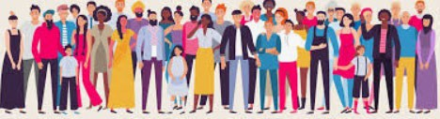
The Strengths of Cultural Competence and Diversity
The ability to collaborate effectively with individuals from different culture to improve health care experiences and outcomes.
Offers an environment of inclusion, that is supportive and collaborative and increases productivity and loyalty.
Promotes equity to alleviate healthcare disparities and improve health care outcomes in these patient populations.
Encourages interaction among diverse people to enrich the educational experience, promote personal growth and enhance the community.
Fosters mutual respect, value differences and promotes cross cultural understanding.
Prepares community members to live and work in a competitive global economy.

Slide 20
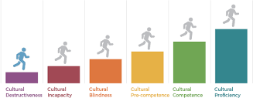
Cultural Competence Continuum
Cultural competence at the organizational and individual levels is an ongoing developmental process.
The following chart is designed to highlight selected characteristics that organizations may demonstrate along the stages of the cultural competence continuum.

Slide 21



Communication with Culturally Diverse
Patients
When you work with culturally diverse populations:
Learn culturally specific information.
Know some words and phrases in the patient’s language.
Use trained interpreters who can interpret language as well as cultural cues.
Limit the number of forms and other paperwork.

Slide 22

Do’s of communicating with Limited-English Speakers
Make your statements as specific as possible
Identify members among your team who speak other languages who you know can assist with outreach when connecting with people who speak different languages.
Let the person see your lips as you speak
Be aware of your assumptions
Don’t rush – be patient
Speak a little more slowly but not more loudly
Repeat if necessary
Be careful with your pronunciation
Stick to the main points
Avoid complicated medical jargon

Slide 23
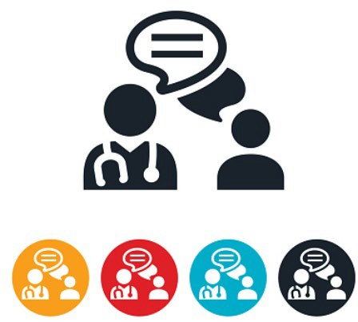
Do’s of communicating with Limited-English Speakers
Emphasize key words
Use simple sentence structure
Keep pencil and paper handy and write key information down
Use body language to illustrate what your words say
Ask the person to write down any words you have difficulty understanding

Slide 24

Citations
chrome-extension://efaidnbmnnnibpcajpcglclefindmkaj/https://sph.unc.edu/wp- content/uploads/sites/112/2013/07/define_diversity.pdf
Jordan, A. (2022, July 28). Importance of diversity in Healthcare & How to promote it. Provo College. https://www.provocollege.edu/blog/the-importance-of-diversity-in-healthcare-how-to-promote-it/
St. George's University. (2018, December 17). The Importance of Diversity in Health Care. Sgu.edu;
Medical Blog | St. George’s University | The SGU Pulse. https://www.sgu.edu/blog/medical/pros-discuss- the-importance-of-diversity-in-health-care/
Budiman, A. (n.d.). Key findings about U.S. immigrants. Pew Research Center. Retrieved May 17, 2023,
from https://www.pewresearch.org/short-reads/2020/08/20/key-findings-about-u-s- immigrants/#:~:text=Today%2C%20more%20than%2040%20million
CDC. (2023, January 5). Disability Impacts All of Us Infographic | CDC. Centers for Disease Control and
Prevention. https://www.cdc.gov/ncbddd/disabilityandhealth/infographic-disability-impacts- all.html#:~:text=Up%20to%201%20in%204
Disability Stats and Facts | Disability Funders Network – The Social Justice Movement of the 21st
Century…Building a Bridge Between Disability and Community Philanthropy. (n.d.).
Www.disabilityfunders.org. https://www.disabilityfunders.org/disability-stats-and-
facts#:~:text=People%20with%20disabilities%20constitute%20the%20largest%20minority%20group%20in
%20the
Medina, C., & Mahowald, L. (2023, January 12). Discrimination and Barriers to Well-Being: The State of
the LGBTQI+ Community in 2022. Center for American Progress.
https://www.americanprogress.org/article/discrimination-and-barriers-to-well-being-the-state-of-the-lgbtqi- community-in-2022/
U.S. Department of Health & Human Services. (2020). Culturally and Linguistically Appropriate Services. Think Cultural Health. https://thinkculturalhealth.hhs.gov/clas
National Institutes of Health. (2021). Cultural respect. National Institutes of Health (NIH).
https://www.nih.gov/institutes-nih/nih-office-director/office-communications-public-liaison/clear- communication/cultural-respect
Agency for Healthcare Research and Quality. (2015, February). Consider Culture, Customs, and Beliefs: Tool #10. Www.ahrq.gov. https://www.ahrq.gov/health-literacy/improve/precautions/tool10.html
•
•

Slide 25

Thank You For
Being An Imperial Network Provider!

