Slide 1

Health equity for providers
David MKI Liu, MD, PhD, JD
Chief Medical Officer

Slide 2
Objectives
Define health equity
Understand pathways between structural factors and individual pathophysiology
Theorize pathways for resilience factors
Outline interventions
Questions?

Slide 3
Why health equity?
It’s the right thing to do
CMS requirement
NCQA requirement
  Align race and ethnicity reporting with Office of Management and Budget categories.
  Include options for “declined” if a member chooses not to provide race or ethnicity.
  Stratify separately by race and ethnicity.
  Allow reporting of self-reported member data and indirect imputed data–regardless of completeness and using separate reporting fields.
  Use existing HEDIS audit and hybrid sampling guidelines.
Martino et al 2019; NCQA 2022

Slide 4
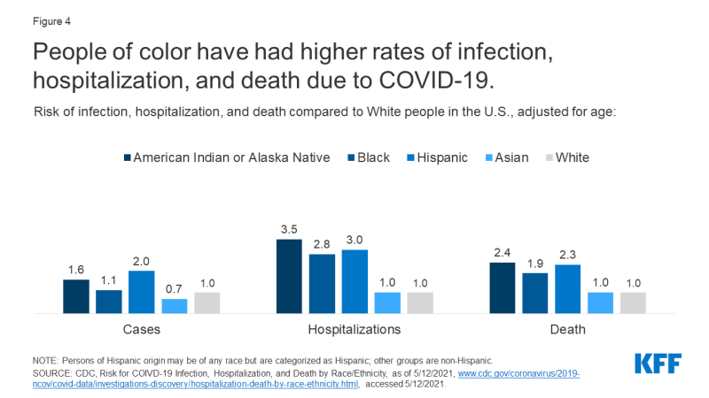
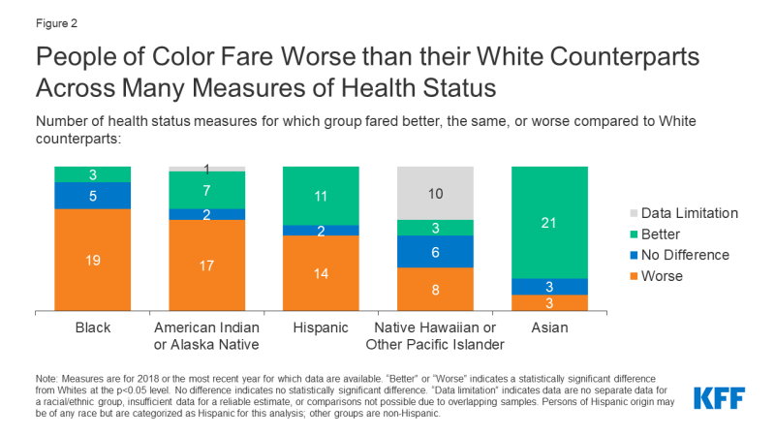
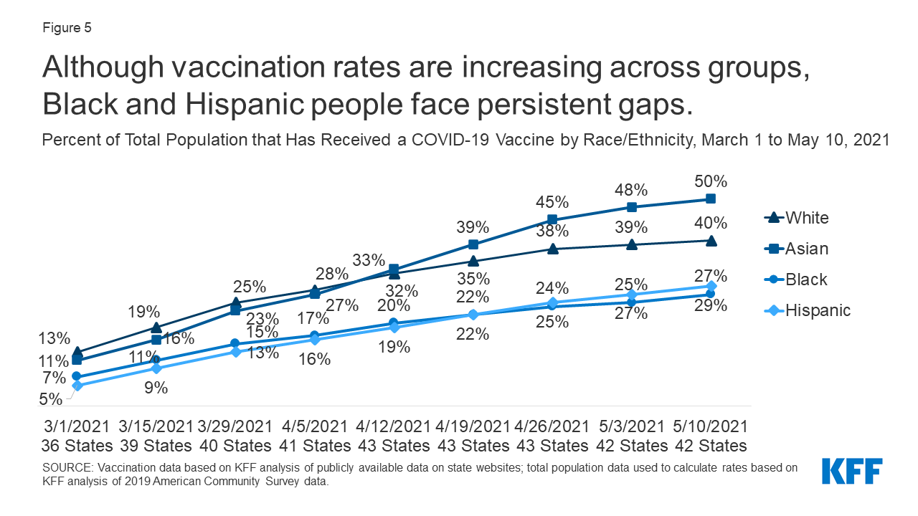
Nduga, Artiga 2021

Slide 5
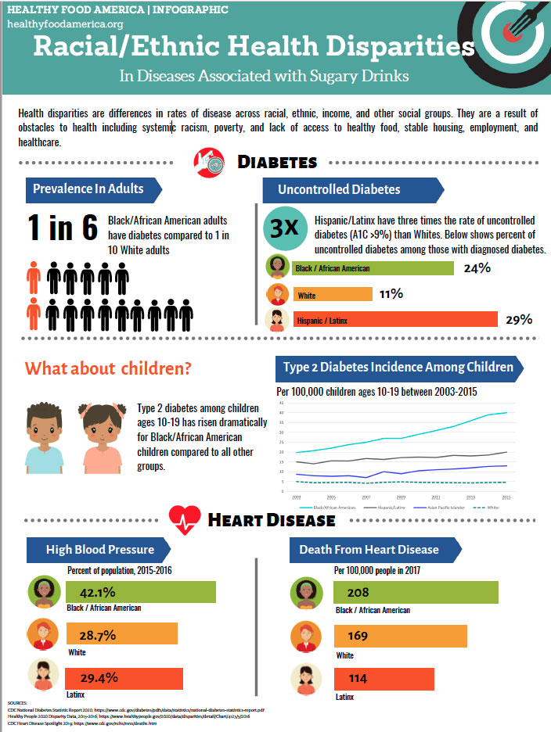
Healthy Food America 2017

Slide 6
Inequities in diabetes mellitus
Characteristic | Diagnosed DM % | Undiagnosed DM % | Total DM %
Total | 11.3 (10.3–12.5) | 3.4 (2.7–4.2) | 14.7 (13.2–16.4)
Age in years
18-44 | 3.0 (2.4–3.7) | 1.9 (1.3–2.7) | 4.8 (4.0–5.9)
45-64 | 14.5 (12.2–17.0) | 4.5 (3.3–6.0) | 18.9 (16.1–22.1)
≥ 65 | 24.4 (22.1-27.0) | 4.7 (3.0–7.4) | 29.2 (26.4–32.1)
Sex
Men | 12.6 (11.1–14.3) | 2.8 (2.0–3.9) | 15.4 (13.5–17.5)
Women | 10.2 (8.8–11.7) | 3.9 (2.7–5.5) | 14.1 (11.8–16.7)
Race/ethnicity
White, non-Hispanic | 11.0 (9.4–12.8) | 2.7 (1.7–4.2) | 13.6 (11.4–16.2)
Black, non-Hispanic | 12.7 (10.7–15.0) | 4.7 (3.3–6.5) | 17.4 (15.2–19.8)
Asian, non-Hispanic | 11.3 (9.7–13.1) | 5.4 (3.5–8.3) | 16.7 (14.0–19.8)
Hispanic | 11.1 (9.5–13.0) | 4.4 (3.3–5.8) | 15.5 (13.8–17.3)
CDC 2021

Slide 7
During the pandemic
Cardiovascular disease deaths | 2019 (per 100,000) | 2020 | RR
Non-Hispanic Whites | 1208.7 | 1234.2 | 1.19 (1.02-1.03)
Non-Hispanic Blacks | 1503.8 | 1783.7 | 1.19 (1.17-1.20)
Non-Hispanic Asian | 577.4 | 685.7 | 1.19 (1.15-1.22)
Hispanic | 820.4 | 968.5 | 1.18 (1.16-1.20)
Cerebrovascular disease deaths | 2019 | 2020 | RR
Non-Hispanic Whites | 258.2 | 268.7 | 1.04 (10.3-1.05)
Non-Hispanic Blacks | 379.7 | 430.7 | 1.13 (1.10-1.17)
Non-Hispanic Asian | 207.4 | 236.5 | 1.15 (1.09-1.21)
Hispanic | 235.9 | 264.4 | 1.12 (1.08-1.16)
Wadhera et al 2021

Slide 8
Definitions of health equity
WHO: “absence of unfair, avoidable or remediable differences among groups of people, whether those groups are defined socially, economically, demographically, or geographically or by other dimensions of inequality (e.g. sex, gender, ethnicity, disability, or sexual orientation). Health is a fundamental human right. Health equity is achieved when everyone can attain their full potential for health and well-being”
CDC: Health equity is achieved when every person has the opportunity to “attain his or her full health potential” and no one is “disadvantaged from achieving this potential because of social position or other socially determined circumstances.” Health inequities are reflected in differences in length of life; quality of life; rates of disease, disability, and death; severity of disease; and access to treatment.
WHO 2022; CDC 2022a

Slide 9
Social determinants of health
Conditions in which people live, learn, work, play and age
Inequities in SDOH result in unequal distribution of power, money and resources according to race/ethnicity, gender, gender expression, sexual orientation, language, geography and other factors
So, health inequities are product of inequities in SDOH factors x inequities in underlying distribution of power, money and resources
CDC 2022b; CDC 2022c; Islam 2019; National Academies 2017

Slide 10
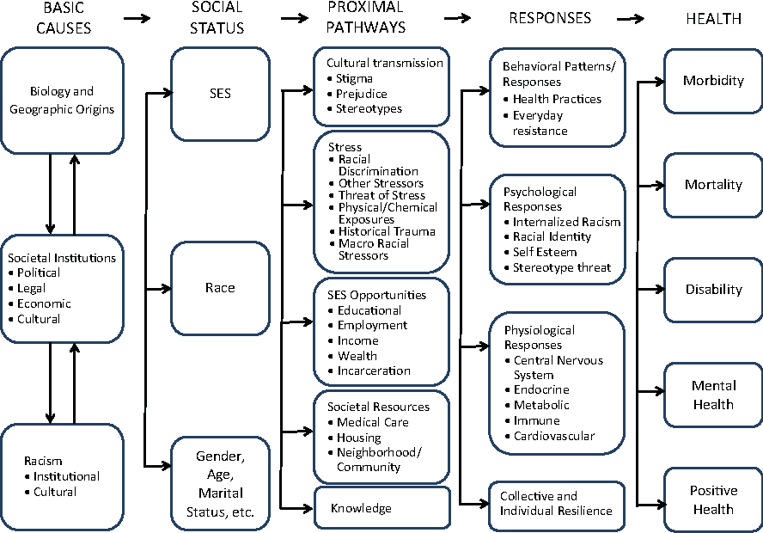

Slide 11
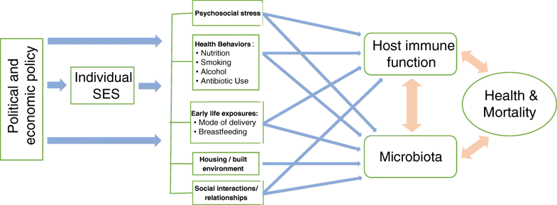
Dowd et al 2018.

Slide 12
Mechanisms
Chronic stress
Developmental origins of health and disease/fetal programming
Epigenetics
Allostatic load
Multigenerational trauma

Slide 13
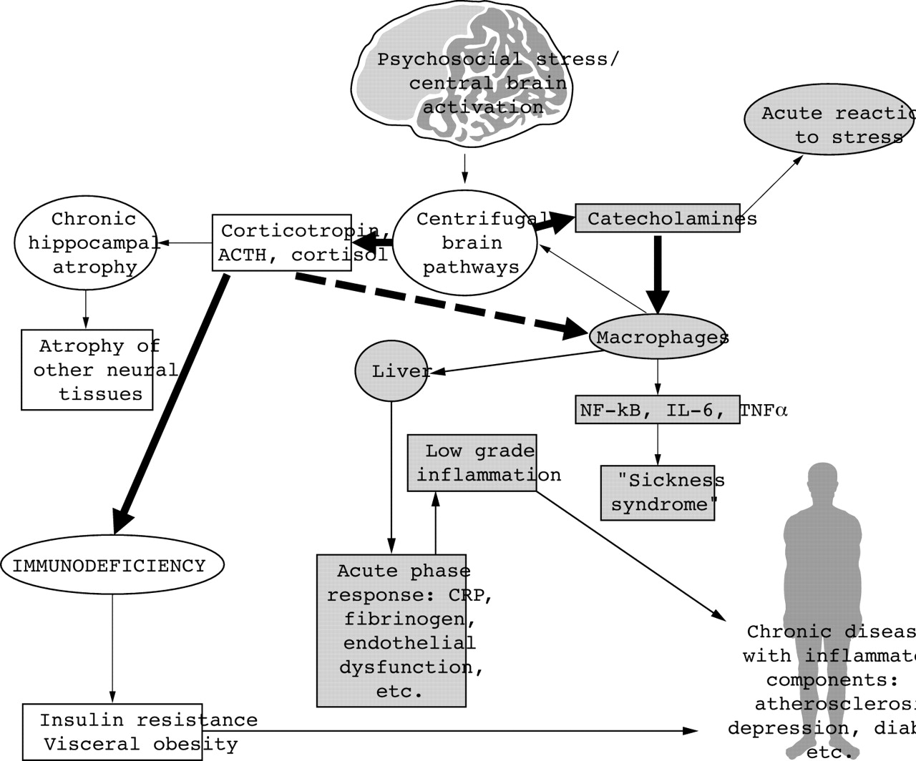

Vale Postgrad Med J 2005;81:429-435

Slide 14
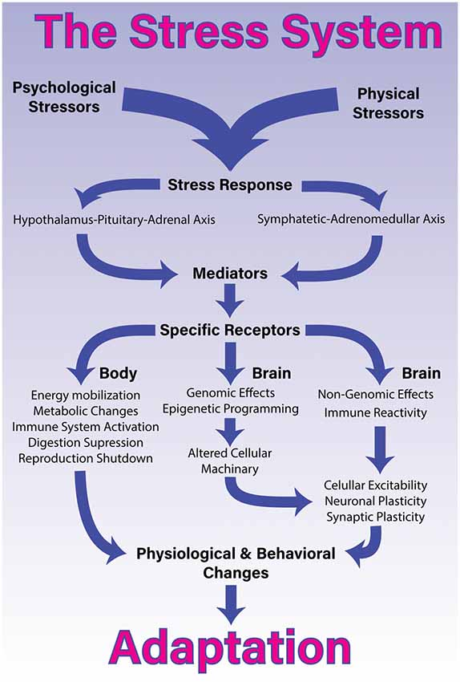
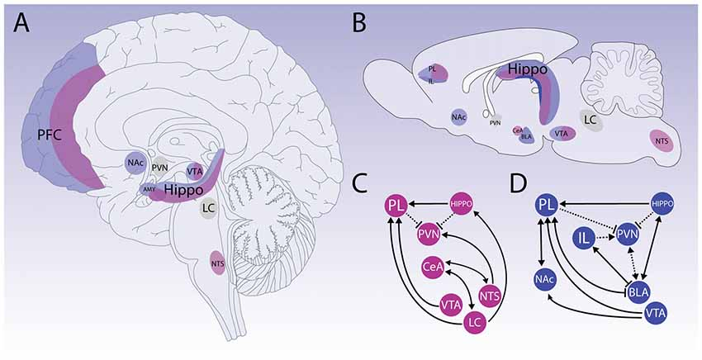
Godoy et al 2018

Slide 15
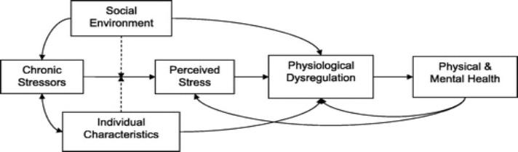
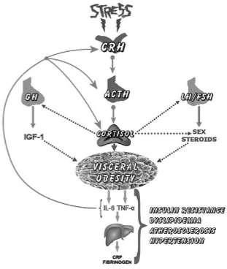
Glei 2007

Slide 16
Developmental origins of health and disease/fetal programming
DOHaD
  Fetal/postnatal programming
    Fetal undernutrition (SGA) and overnutrition (diabetic mother)
    ↑ risk of future DM
      ↑ adiposity
      May also affect HTN, osteoporosis, spontaneous hypothyrdoidism, schizophrenia, depression
    Fetal programming restricts future options for fetus
      Mismatch between programming and later environment → disease
Yajnik 2008; Aagaard-Tillery 2008

Slide 17
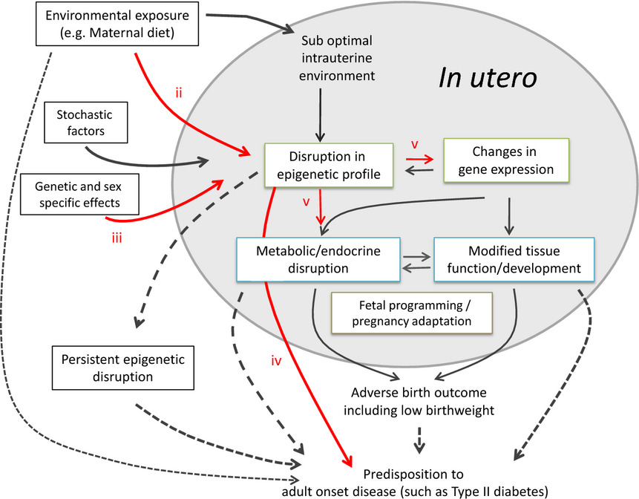
Epigenetics as the mediator of fetal programming of adult onset disease: what is the evidence?
Acta Obstet Gynecol Scand, Volume: 93, Issue: 11, Pages: 1090-1098, First published: 17 May 2014, DOI: (10.1111/aogs.12431)
Notes:
A role for epigenetics in fetal programming/DOHaD? It has been proposed that fetal exposure to an inadequate intrauterine environment can result in a permanent adaptation of the developing fetus, potentially involving altered tissue physiology, hormone production, and glucose and lipid metabolism . The molecular mechanism(s) underlying this phenomenon are largely speculative but are unlikely to be encoded in the DNA sequence. Stable epigenetic disruption has emerged as a prime candidate for the environmentally mediated molecular changes underpinning fetal programming. Prerequisites for establishing a causal link include; (i) demonstrating inter‐individual epigenetic variability in early life (including at birth – data not shown), (ii) in response to specific environmental exposures and/or (iii) genetic factors. Further, (iv) compelling evidence linking epigenetic change to disease, prior to onset is required. Finally, (v) the functional relevance of specific epigenetic variants must be demonstrated.
IF THIS IMAGE HAS BEEN PROVIDED BY OR IS OWNED BY A THIRD PARTY, AS INDICATED IN THE CAPTION LINE, THEN FURTHER PERMISSION MAY BE NEEDED BEFORE ANY FURTHER USE. PLEASE CONTACT WILEY'S PERMISSIONS DEPARTMENT ON PERMISSIONS@WILEY.COM OR USE THE RIGHTSLINK SERVICE BY CLICKING ON THE 'REQUEST PERMISSIONS' LINK ACCOMPANYING THIS ARTICLE. WILEY OR AUTHOR OWNED IMAGES MAY BE USED FOR NON-COMMERCIAL PURPOSES, SUBJECT TO PROPER CITATION OF THE ARTICLE, AUTHOR, AND PUBLISHER.

Slide 18
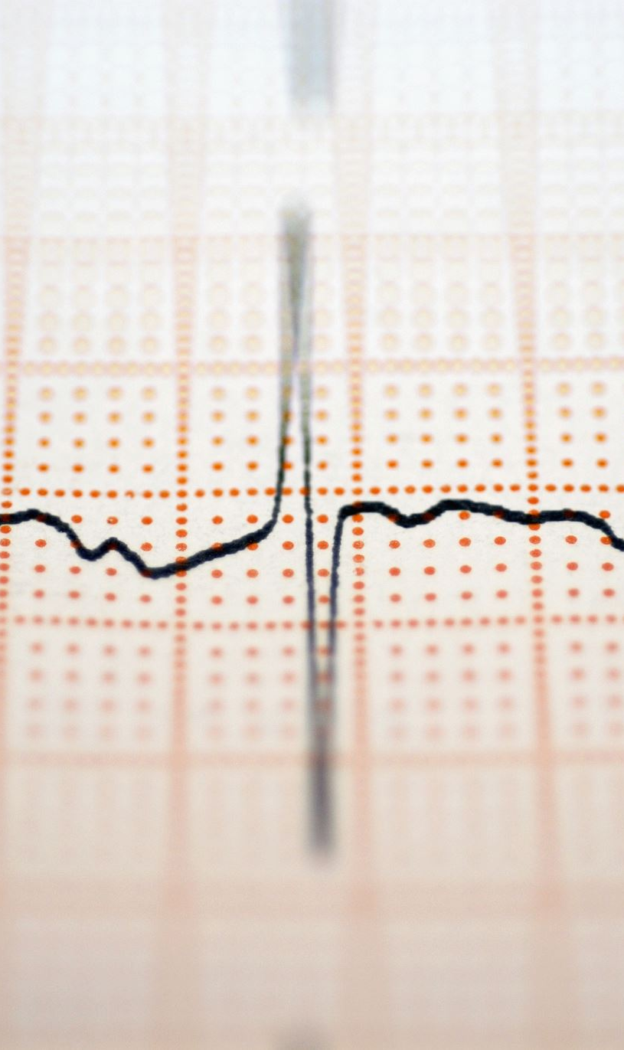
Allostatic load
Cumulative measure of the body’s response to adapting to lifetime of stress
  Markers of dysregulation across all major regulator systems
  Higher allostatic load → increased change that person will experience negative income
  Allostatic load increases sharply across ages 20 – 60, then levels off
Seeman 2001; Crimmins 2003

Slide 19
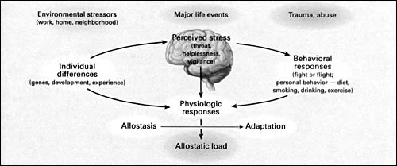

Slide 20
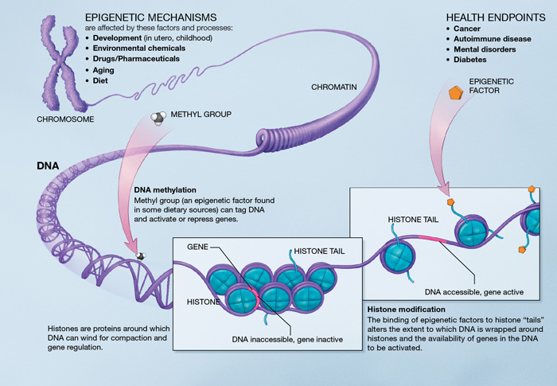
Epigenetics
Potentially Heritable changes in gene transcription and/or phenotypical expression not related to changes in DNA sequence
Histones modification: methylation and acetylation
  Histone variants
Dna methylation
ATP – dependent chromatin remodeling
Noncoding RNA gene regulation
Changes in molecular architecture
Imprinting of HPA axis in offspring by maternal stress
Martos et al 2015; Cadet 2014; NIH
Notes:
Effects of maternal imprinting can be remediated through environmental modification, pharmaceutical or behavioral interventions

Slide 21
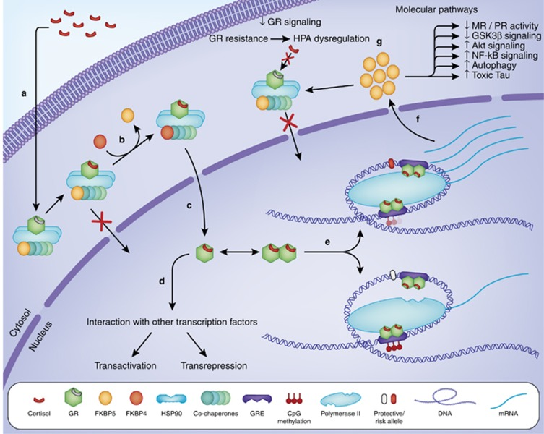
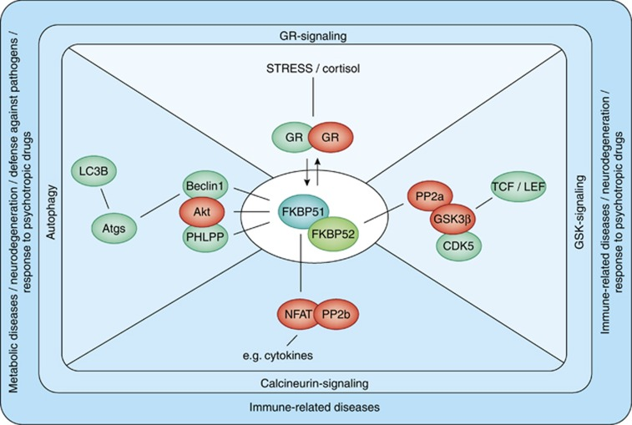
One example – FKBP5
Notes:
Schematic representation of the molecular events involved in glucocorticoid-mediated FKBP5 induction, the resulting intracellular negative feedback loop, and effects on other biological processes. Glucocorticoids enter the cytoplasm (a) and activate the glucocorticoid receptor (GR) complex. FKBP5 binding to the complex reduces affinity of glucocorticoids to the GR and delays translocation of the GR to the nucleus. However, exchange of FKBP5 for FKBP4 (b) results in GR translocation to the nucleus (c). The GR can either interact as a monomer with other transcription factors (d) or form a homodimer that binds to DNA at glucocorticoid response elements. Overall, GR functions result in transactivation or transrepression of a large number of genes. The FKBP5 gene is highly responsive to GR, but responsiveness depends on FKBP5 polymorphisms and methylation status (e). The synthesized FKBP5 mRNA translocates to the cytoplasm (f) where it is translated into FKBP5 protein. FKBP5 then inhibits GR activity not only forming an ultra-short, intracellular negative feedback loop of GR signaling but also modulating several other biological pathways (g).
FKBP51 exerts an inhibitory effect on GR function, thus having a crucial role in stress physiology. FKBP51 further interacts with PHLPP, Akt, and Beclin1 and affects Akt/Beclin1-driven autophagy. As PHLPP dephosphorylates Akt at serine 473, inactive Akt is recruited to Beclin1, resulting in lower inhibitory phosphorylation of Beclin1 and thus the induction of autophagic pathways. Impact on autophagy might be a link of FKBP51 with diseases characterized by defective autophagy, including neurodegeneration, inflammatory diseases, and aging. FKBP51 further interacts with CDK5 and PP2A resulting in inhibition of GSK3β and activation of promoters targeted by the transcription factors TCF/LEF. FKBP51 shows high affinity to calcineurin (PP2b), and high levels of FKBP51 result in inhibition of PP2b-directed NFAT-signaling, thus affecting T-cell proliferation and function. Green color represents activation and red color represents inhibition by FKBP51.

Slide 22
Epigenetics and the brain
Cortical neurons reprogram throughout entire life
  Two reprogramming events in development
  Learning and memory
    NMDA and Gaba receptors
      Neurotransmitter release and epigenetic changes to dna methylation, acetylation and hydroxymethalation
Epigenetic marks record biological experiences and may be mechanism of memory
  Higher maternal care 🡪 epigenetic marks 🡪 higher care from offspring to their offspring
Coexpression of genes in placenta and hypothalamus
  Peg3 and maternal care
Vassoler, Sadri-Vakili, 2014; Wes, Orlando 2014, Orlando 2014
Notes:
Maternal hypothalamus → placenta → fetal hypothalamus
PEG3 – cell proliferation, p53 mediated apoptosis, fetal growth rate and nurturing

Slide 23
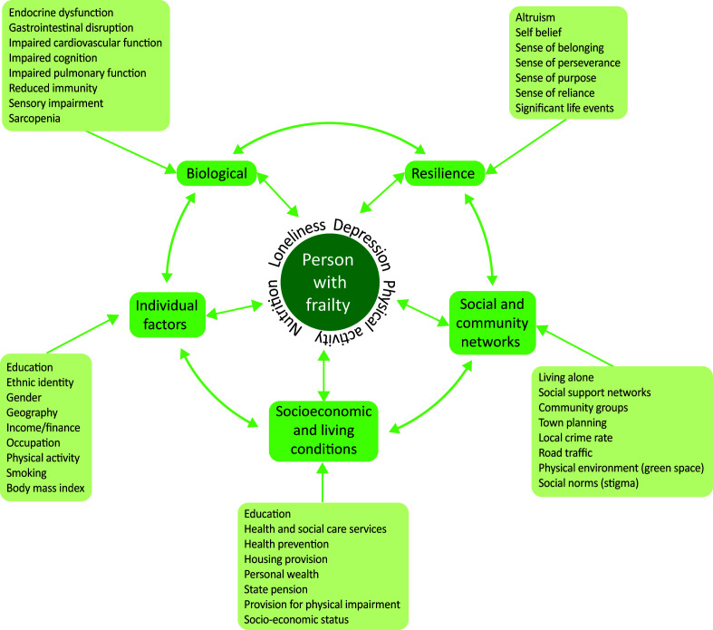

Slide 24
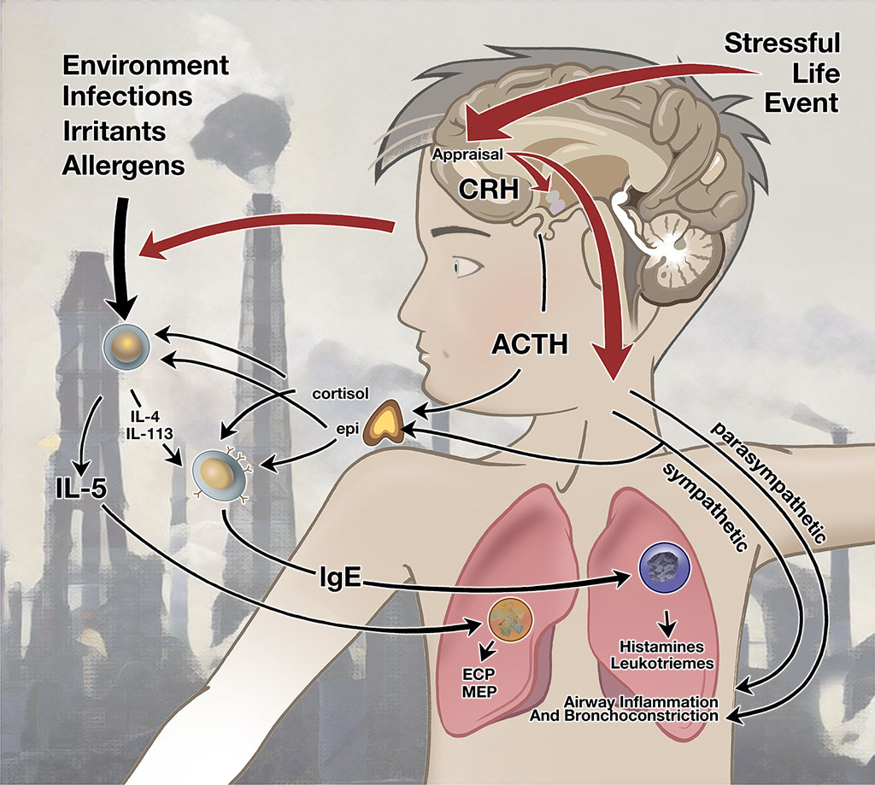
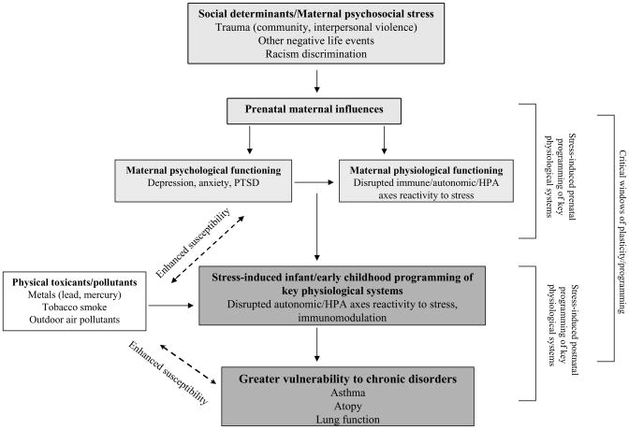
Wright 2011

Slide 25
Intergenerational trauma
Destruction of societal anxiety buffers
  Approach-avoidance and learned helplessness
  Structure of brains altered
    Suspicion, defensiveness and uncooperativeness
    HPA axis activation
    Negative impact on emotional, social, intellectual development
      Abnormalities in corpus callosum, cerebral cortex, hippocampus
Yehuda, Lehrner 2018; Yellow Horse Brave Heart, Chase, Elkins Altschul 2011

Slide 26
Intergenerational trauma
Direct or indirect passage of violence done onto one generation to the next
  Interpersonal (parent to child) → intergenerational (parents to children)
Transmission
  Direct: parents treat children in same abusive or negligent ways that they were treated
  Indirect: children learn coping behaviors from their parents
    Fear, anxiety, helplessness → EtOH, family discord, high suicide rates
In Hawai‛i
  Epidemics of disease
  Dispossession from traditional lands
  Blood quanta
  Cultural genocide
    Limits on traditional and customary rights
    Marriage and property rights
    Linguistic ban
Yehuda, Lehrner 2018; Bissen 2020

Slide 27
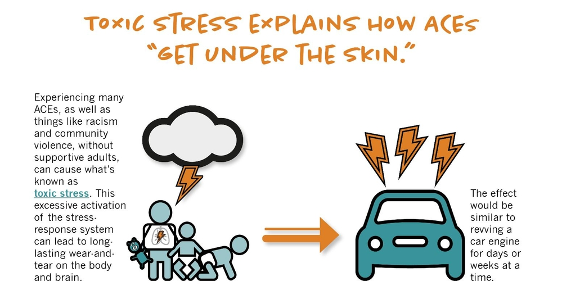
ACES and PCES
PACESconnection.com 2022

Slide 28
ACE | PCE
Recurrent physical abuse | Strong connection with family
Repeated emotional abuse | Powerful connections w/ positive peers
Sexual abuse | Loving, trusting connection w/ non-parental adult
Exposure to substance abuse in the home | Opportunities to develop self-esteem
Incarcerated family member | Feeling like valued member of the community
Family member who has SPMI or institutionalized | Positive parenting practices
Exposure to abuse of parent | Feel sense of belonging at school
One or no parents | Enjoy participating in community traditions.
Emotional or physical neglect | Physical activity
 | Having a hobby
 | Living in a clean, safe home with enough food
 | Having routines and fair rules at home
 | Spending time with a best friend
There is a positive dose-response between PCE and reduced ACES
Parent Trust for Washington Children, 2022; Bethell et al 2019; Ratliff et al 202

Slide 29
ACES
ACES have dose response relation to chronic disease and health harming behaviors
  ≥ 4 ACES → ⌂ 250% panic, 360% depressive affect, 240% anxiety, 270% psychosis
ACES are very prevalent – 64% in Kaiser study
Health harming behaviors become coping skills for persons with high ACE exposure

Slide 30
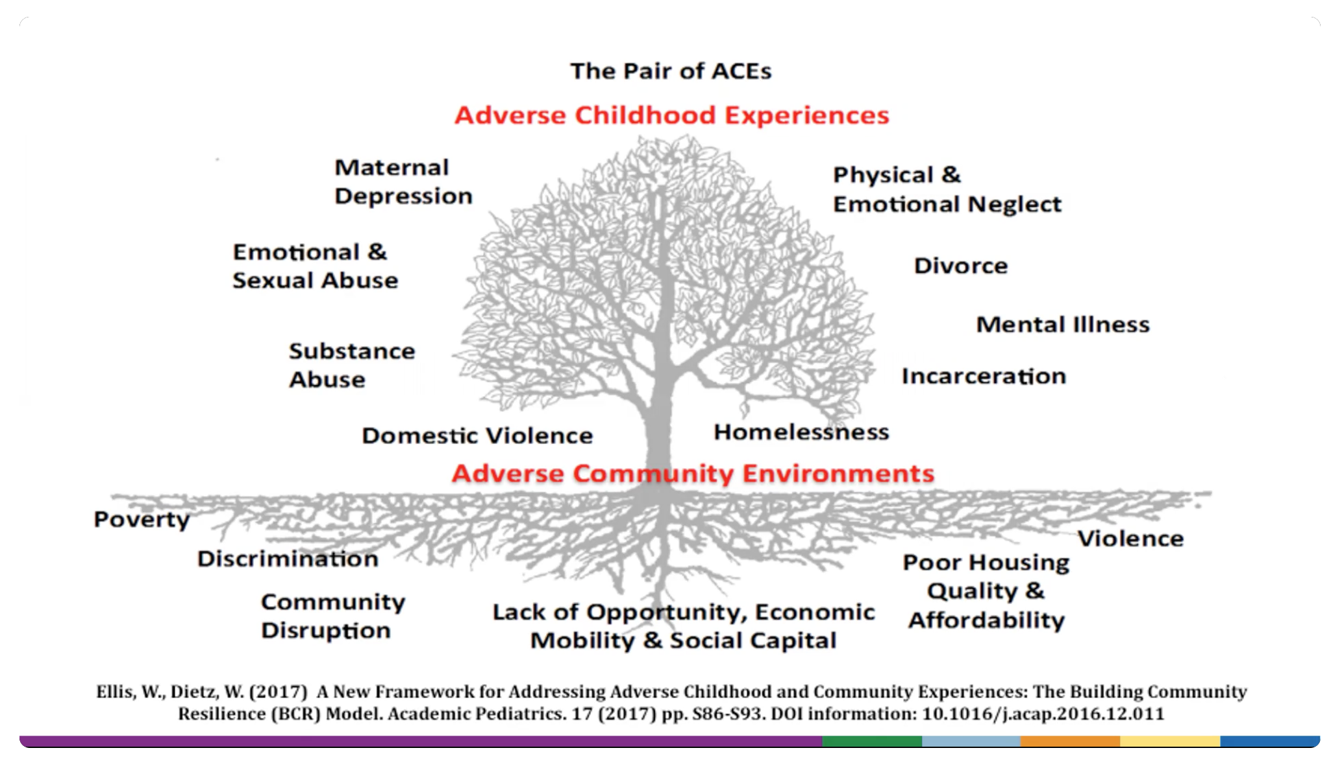

Slide 31
Equity and resilience
Adapting well in the face of adversity, trauma, tragedy or threats
Coping with significant stress caused by problematic and toxic relationships and the ability to rebound from difficult experiences
Individual, community and systemic levels
Capacities
Absorptive
Adaptive
Anticipatory
Transformative
Resilience articulates with self-determination
van der Wel et al 2015

Slide 32
Interventions
PRAPARE: assessing health equity
Authentic healing relationship – cultural humility, mindful listening, joint decisionmaking
Healthy Neighborhoods Healthy Families
Community-based participatory research
Community organizing
Locating and sustaining indigenous agency and identity: survivance
Nurturing relationships and enriched environments
Adult PACES plan
Trauma-informed practices
NEJM Catalyst 2017; Kirmayer et al 2011

Slide 33
Interventions 2
MBSR
Meditation and prayer
Hays-Grudo 2020
Notes:
Mbsr mindfulness based stress reduction

Slide 34
References
Bethell C, Jones J, Gombojav N, Linkenbach J, Sege R. Positive Childhood Experiences and Adult Mental and Relational Health in a Statewide Sample: Associations Across Adverse Childhood Experiences Levels. JAMA Pediatr. 2019 Nov 1;173(11):e193007. doi: 10.1001/jamapediatrics.2019.3007. Erratum in: JAMA Pediatr. 2019 Sep 30;: PMID: 31498386; PMCID: PMC6735495.
Bissen, T. (2020). Trauma, Healing, and Justice: Native Hawaiian Women in Hawaii’s Criminal Justice System. In: George, L., Norris, A.N., Deckert, A., Tauri, J. (eds) Neo-Colonial Injustice and the Mass Imprisonment of Indigenous Women. Palgrave Studies in Race, Ethnicity, Indigeneity and Criminal Justice. Palgrave Macmillan, Cham. https://doi.org/10.1007/978-3-030-44567-6_10
Carlton B, Goebert DA, Bell CK, Horton M, Else IRN … Yamada L. Integrating cultural values into mental health treatment. Hulili: Multidisciplinary Research on Hawaiian Well-Being. 2011; 7(1):159—84
Daniels B. Indigenous identity is rooted in language, land and sovereignty. CBC News. March 22, 2018. Available at: https://www.cbc.ca/news/indigenous/opinion-indigenous-language-land-sovereignty-1.4588138. Accessed October 25, 2019.
Centers for Disease Control and Prevention (CDC 2022a). Health equity. Washington, DC: CDC, 2022. Available at: https://www.cdc.gov/chronicdisease/healthequity/index.htm. Accessed April 13, 2022.
Centers for Disease Control and Prevention (CDC 2022b). Social determinants of health. Washington, DC: CDC, 2022. Available at: https://www.cdc.gov/chronicdisease/programs-impact/sdoh.htm. Accessed April 13, 2022.
Centers for Disease Control and Prevention (CDC 2022c). Social determinants of health. Washington, DC: CDC, 2022. Available at: https://www.cdc.gov/socialdeterminants/about.html. Accessed April 13, 2022.
Centers for Disease Control and Prevention. Prevalence of both diagnosed and undiagnosed diabetes. 2021. Available at: Prevalence of Both Diagnosed and Undiagnosed Diabetes | Diabetes | CDC. Accessed at April 14, 2022.
Dowd JB, Renson A. Curr Epidemiol Rep 2018; 5: 432. https://doi.org/10.1007/s40471-018-0167-7
Flood D, Rohloff P. Indigenous languages and global health. Lancet Global Health. 2018. 6(2): PE1234-E135. https://doi.org/10.1016/S2214-109X(17)30493-X.
Godoy LD, Rossignoli MT, Delfino-Pereira P, Garcia-Cairasco N, de Lima Umeoka EH. A comprehensive overview on stress neurobiology: basic concepts and clinical implications. Frontiers Behav Neurosci. 12:127. doi: 10.3389/fnbeh.2018.00127.

Slide 35
References 2
Hays-Grudo J. ACES and PACEs: advserse and protective childhood experiences. ACOFP Intensive Osteopathic Update, 2020. Available at: https://www.acofp.org/acofpimis/Acofporg/PDFs/IOU20/handouts/Saturday_15_100_Jennifer_Hays-Grudo.pdf. Accessed May 4, 2022.
Hale M, Shah S, Clegg A. Frailty, inequality and resilience. Clin Med (Lond). 2019;19(3):219-223. doi:10.7861/clinmedicine.19-3-219
Healthy Food America. Racial/ethnic disparities in diseases associated with sugary drinks. Available at: https://www.healthyfoodamerica.org/racial_ethnic_health_disparities. Accessed April 13, 2022.
Islam MM. Social Determinants of Health and Related Inequalities: Confusion and Implications. Front Public Health. 2019;7:11. Published 2019 Feb 8. doi:10.3389/fpubh.2019.00011
Martino SC, Elliott MN, Dembosky JW, Hambarsoomian K…Haviland AM. Racial, ethnic and gender disparities in health care in Medicare Advantage. Baltimore, MD: CMS Office of Minority Health, 2019.
National Academies of Sciences, Engineering, and Medicine; Health and Medicine Division; Board on Population Health and Public Health Practice; Committee on Community-Based Solutions to Promote Health Equity in the United States; Baciu A, Negussie Y, Geller A, et al., editors. Communities in Action: Pathways to Health Equity. Washington (DC): National Academies Press (US); 2017 Jan 11. 3, The Root Causes of Health Inequity. Available from: https://www.ncbi.nlm.nih.gov/books/NBK425845/
NCQA. Data measurement and equity. Stratifying HEDIS measures by race & ethnicity. Washington, DC: NCQA, 2022. Available at: https://www.ncqa.org/about-ncqa/health-equity/data-and-measurement/. Accessed April 14, 2022
Ndugga N, Artiga S. Disparities in health and health care: 5 key questions and answers. Kaiser Family Foundation, 2021. available at: https://www.kff.org/racial-equity-and-health-policy/issue-brief/disparities-in-health-and-health-care-5-key-question-and-answers/. Accessed April 13, 2022.

Slide 36
References 3
NEJM Catalyst. Social determinants of Health (SDOH). 2017. doi/full/10.1056/CAT.17.0312
Parent Trust for Washington Children. Positive childhood experiences. 2022. available at: Positive Childhood Experiences – Parent Trust for Washington Children. Accessed May 4. 2022
Ratliff E, Sheffield Morris A, Hays-Grudo J. PACES for children: overcoming adversity and building resilience. OSU Extension. May, 2020. Available at: https://extension.okstate.edu/fact-sheets/paces-for-children-overcoming-adversity-and-building-resilience.html.
Saffery R, Nvakovic B. Epigenetics as the mediator of fetal programming of adult onset disease: what’s the evidence? Acta Obestertricia et Gynecologica Scandinavica. 93;2014:1090-1098. doi.org/10.1111/aogs.12431
van der Wel KA, Bambra C, Dragano N… Lunau T. Risk and resilience: health inequalities, working conditions and sickness benefit arraignments: an analysis of the 2010 European Working Conditions survey. Sociology of Health & Illness Vol. 37 No. 8 2015 ISSN 0141-9889, pp. 1157–1172 doi: 10.1111/1467-9566.12293
Wadhera RK, Figuerora JF, Rodriguez F…Joynt Maddox KE. Racial and ethnic disparities in heart and cerebrovascular disease deaths during the COVID-19 pandemic in the United States. Circulation 2021;143(24):2346-2354. https://doi.org/10.1161/CIRCULATIONAHA.121.054378
Williams DR, Mohammed SA. Racism and health I: pathways and scientific evidence. Am Behav Sci. 2013; 57: 1152. doi: DOI: 10.1177/0002764213487340.
World Health Organiation. Health equity. Geneva, Switzerland: WHO, 2022. Available at: https://www.who.int/health-topics/health-equity#tab=tab_1. Accessed April 13, 2022.
Wright RJ. Epidemiology of stress and asthma: from constricting communities and fragile families to epigenetics. Immunology and Allergy Clinics of North America. 2011 Feb;31(1):19-39. DOI: 10.1016/j.iac.2010.09.011. PMID: 21094921; PMCID: PMC3052958.
Yehuda R, Lehrner A. Intergenerational transmission of trauma effects: putative role of epigenetic mechanisms. World Psychiatry. 2018;17(3):243-257. doi:10.1002/wps.20568
Yellow Horse Brave Heart MY, Chase J, Elkins J, Altschul DB. Historical trauma among Indigenous Peoples of the Americas: concepts, research, and clinical considerations. J Psychoactive Drugs. 2011 Oct-Dec;43(4):282-90. doi: 10.1080/02791072.2011.628913. PMID: 22400458.
Zannas AS, Wiechmann T, Gassen NC, Binder EB. Gene-Stress-Epigenetic Regulation of FKBP5: Clinical and Translational Implications. Neuropsychopharmacology. 2016 Jan;41(1):261-74. doi: 10.1038/npp.2015.235. Epub 2015 Aug 13. PMID: 26250598; PMCID: PMC4677131.
Ziglio E. Strengthening resilience: a priority shared by Health 2020 and the Sustainable Development Goals. Geneva, Switzerland: WHO, 2017.

